Slide 1

Saftey Helmet
Detection
By: Njood Alqahtani & Reem Alsuqaih

Slide 2
TABLE OF CONTENTS
01
02
03
Introduction
Problem Statement
Methodology
04
05
06
Dataset
Experiment & Demo
Conclusion

Slide 3

01
Introduction

Slide 4

Introduction
Based on the Kingdom’s 2030 vision for artificial intelligence applications to enhance safety procedures in factories where wearing safety helmets can effectively protect workers safety on construction sites. Hence, detecting safety helmet wearing is a vital step of construction sites safety management. Therefore, this model proposes a deep learning-based method to detect safety helmet wearing at a satisfactory accuracy with high detection speed.

Slide 5

02
Problem Statement

Slide 6

Problem Statement
Head injury is still one of the most common causes of fatal accidents on the jobsite. Since the brain is so sensitive, it can be damaged by contact with the inside of the skull and by compression. Workers on a construction site, or any workplace where heavy objects and machinery operates, without wearing safety helmets will suffer more injuries in accidents such as falling human body and vertical falling matter.

Slide 7

03
Methodology

Slide 8
Methodology
Load Dataset
CNN Experiment
Split the Data
Demo
Conclusion
1
2
3
4
5

Slide 9









04
Dataset
Source
Type
Kaggle & Roboflow
Images

Slide 10


05
Experiment & Demo

Slide 11

CNN Experiment
 | Train | Validation
Loss | 0.06 | 0.24
Accuracy | 0.97 | 0.91

Slide 12
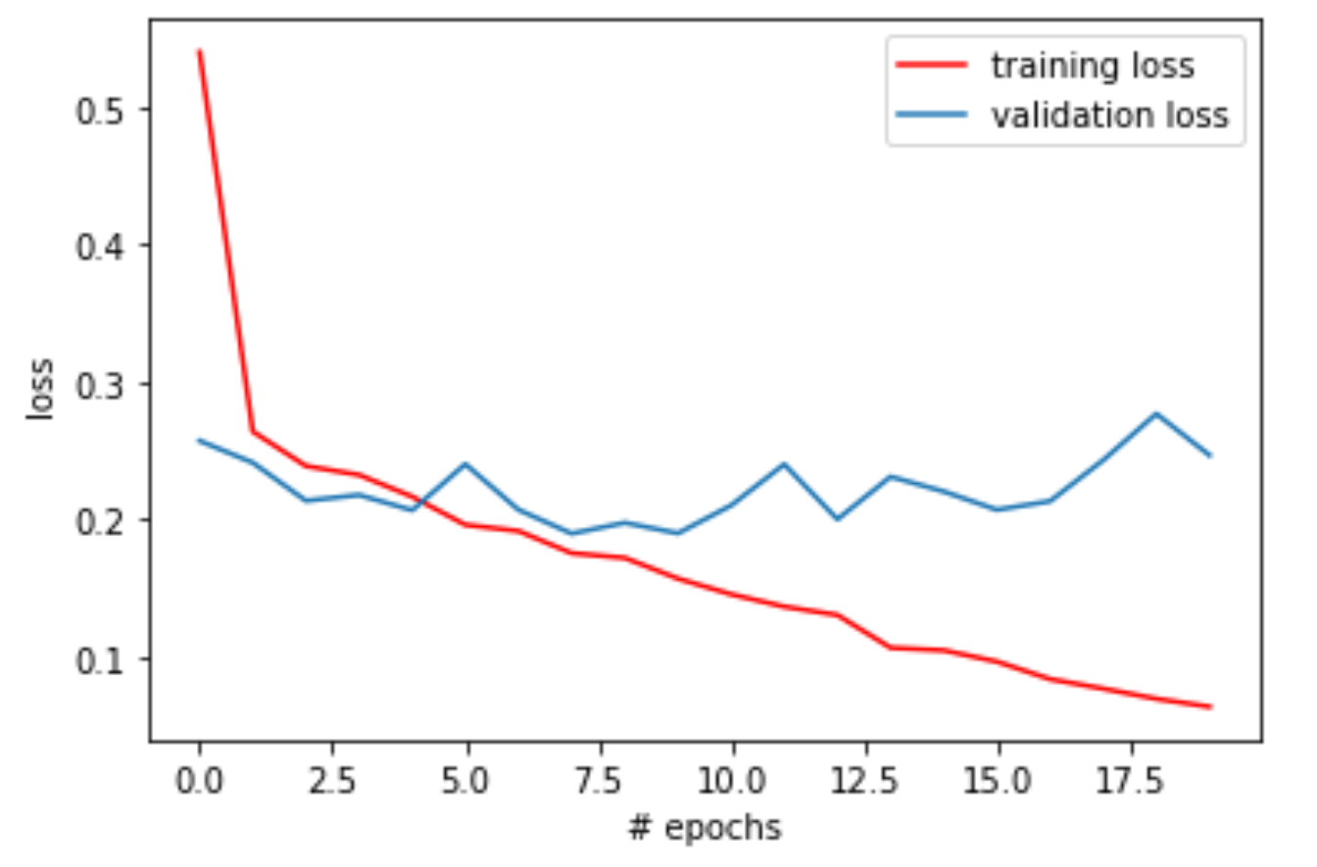
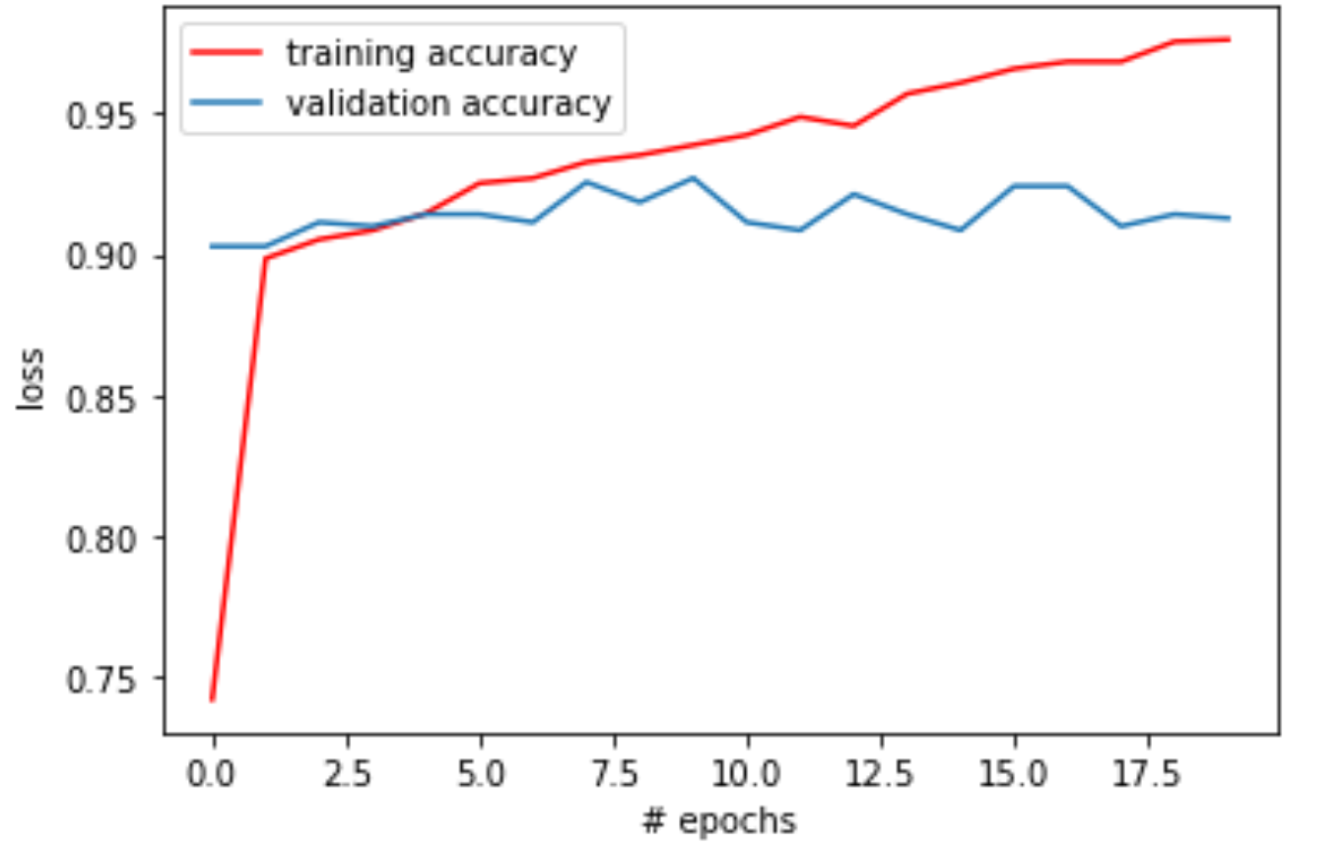
CNN Experiment
Loss
Accuracy

Slide 13
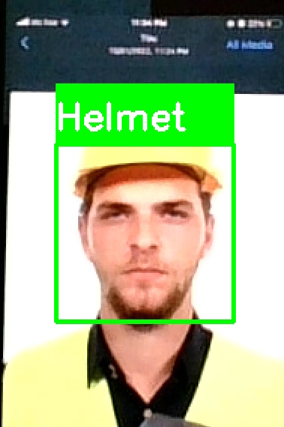
Demo

Slide 14

06
Conclusion

Slide 15
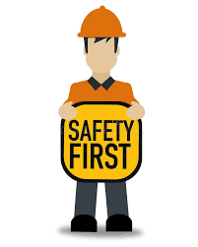
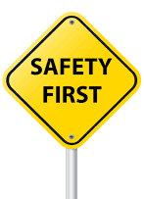
Conclusion
Worker Always should wear a safety helmet to ensure full protection. In extreme cases, these injuries may lead to permanent disability or even death causing irreparable loss.
For future work, we need to collect more data for more accuracy and detect vast and more safety products.

Slide 16

THANKS!

